Slide 1

Machine Learning Project
CROP YIELD ANALYSIS AND PREDICTION
By: Gladys Obol Acaa
2025/HD05/26332U
2500726332

Slide 2
Introduction
Agriculture remains the backbone of many economies. In Uganda the sector accounts for the largest share of employment (47%) and close to 80% of all households in Uganda are involved in agriculture.
Farm productivity is often constrained by unpredictable weather conditions, pest infestations, soil degradation, inefficient use of resources, and lower crop yields which directly affect food security and farmer livelihoods.
Traditional methods of predicting crop yields like maize rely on historical averages and subjective judgments, which are often inaccurate and fail to capture the complexity of modern agricultural ecosystems.
Using Machine Learning models (ML),farmers and agricultural planners can make informed decisions about crop selection, input optimization, and resource allocation ultimately improving yield and sustainability.

Slide 3
Problem Statement
Farmers lack accurate and timely predictions of crop yields due to limited access to intelligent analytical tools. Existing methods are unable to integrate large datasets involving climate, soil quality, and management practices, resulting in yield uncertainty and economic loss.
Therefore, there is a need for a machine learning based system that can analyze farm data and predict yield outcomes to guide farmers in making evidence-based decisions.

Slide 4
Objectives
Specific Objectives
To collect and preprocess data on soil, weather, and crop characteristics.
To train and compare multiple machine learning algorithms for yield prediction (e.g., Logistic Regression, Random Forest,).
To visualize the relationship between different farm parameters and yield outcomes.
Main Objective
To design and develop a Machine Learning–based model for analyzing farm data and predicting crop yields e.g maize with high accuracy.

Slide 5
Literature Review
A variety of agricultural datasets encompassing genomic, phenomic, climatic, and remote sensing data have been utilized to develop ML models for yield prediction.
In Zimbabwe, an applied study combined historical climate data and satellite imagery to train ML models including Random Forest (RF), Support Vector Machines (SVM), and Neural Networks. Results showed RF achieving the highest accuracy (87.5%) in yield prediction.
To fill these gaps, the research objective is to develop a machine-learning based approach to estimate and predict crop yield at a fine scale but over a large area of interest.
To do this, supervised learning algorithms are deployed to calibrate and validate model performance.
Specifically, this report addresses the following questions.
How does model performance vary across different regression and machine-learning approaches?
How useful are ancillary spatial datasets, such as soil properties, rainfall, and temperature variables?
What is the prediction accuracy?

Slide 6
Methodology
Data
Data was collected from Kaggle Agricultural Datasets.
The datasets used in this study include rainfall data, temperature data, crop yield, soil pH and soil nutrients data. It provides insights into various aspects of agriculture, specifically focusing on farm-level details, crop types, soil pH, and associated metrics such as yield, temperature,humidity,and rainfall.
Climate data
Estimates of weather parameters proved to be important predictors of crop yield. The variables include temperature and humidity.
Soil properties
Crop yield may be evidently affected by soil properties such as fertility level and water holding capacity. Soil pH and soil nutrients properties were selected in the analysis.
Research Method
Systematic literature review of work done before.

Slide 7
Methodology cont’d
Tools used
Python, jupyter Notebook for programming
Scikit Learn,Random Forest, Pandas, Numpy, Matplotlib, Plotly, seaborn for data handling.
I tested a variety of prediction approaches, including regression-based machine learning algorithms, i.e. support vector machine (SVM), regression, and random forests.
Regression-based methods can capture the spatial variation of the yield and derive the general relationship between yield and biophysical variable measurements.
Random Forest – The ensemble nature of Random Forest, coupled with techniques like bagging and feature randomness, makes it robust to overfitting, especially when dealing with noisy or high-dimensional datasets.
Support Vector Machine – can be used for both linear and non-linear classification tasks, making them a flexible choice for different types of data.

Slide 8
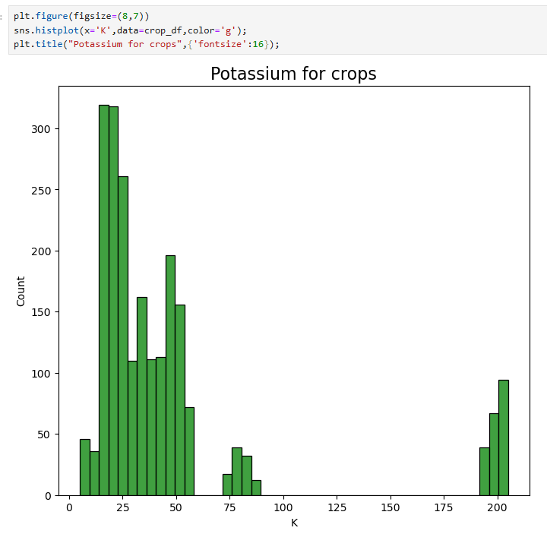
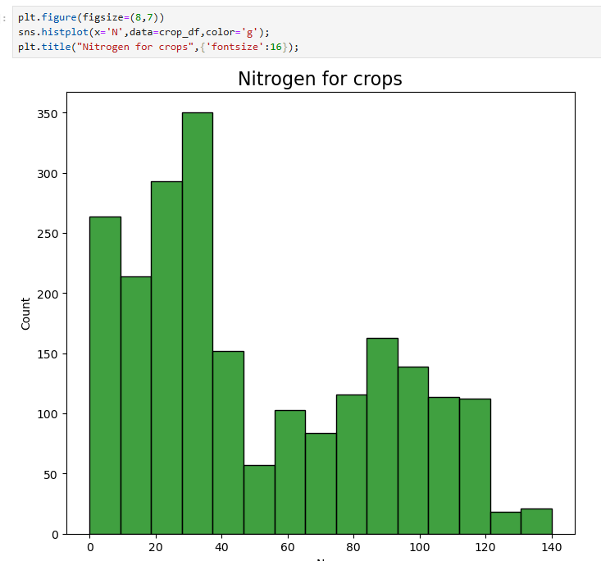
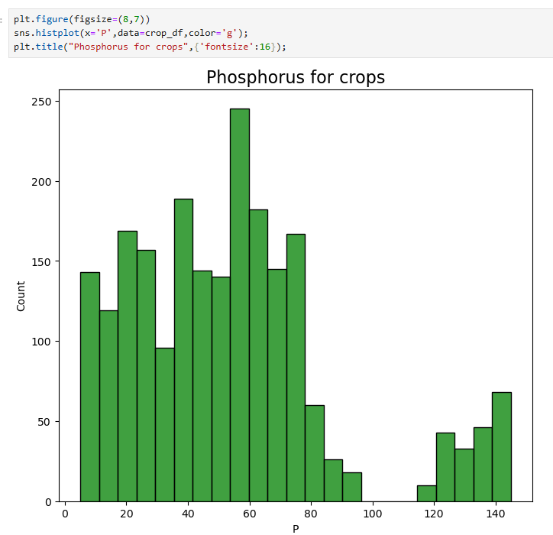
Results
EXPLORATORY DATA ANALYSIS
For:
The soil nutrient properties of Nitrogen, Phosphorus and Potassium.
The soil pH
Climate data of temperature, rainfall and humidity.
IMPORTANCE OF SOIL NUTRIENTS
Nitrogen is an essential nutrient for plant growth, development and reproduction.
The rate of respiration by plants is largely the determining factor for proper uptake and transport of potassium by plants.
Phosphorus is important for cell division and development of new tissues.

Slide 9
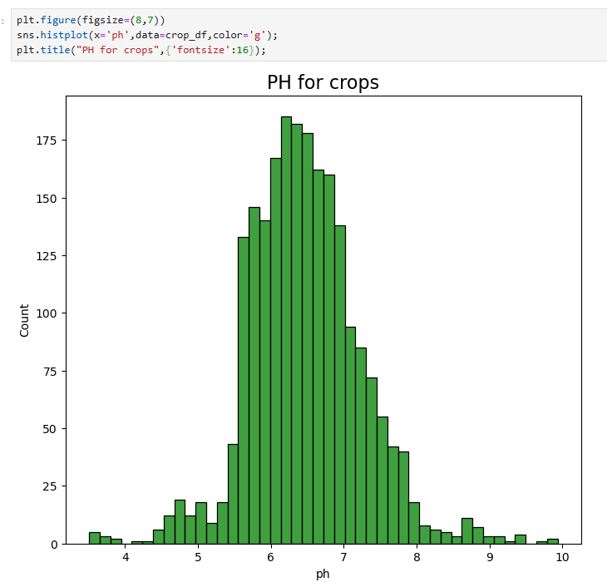
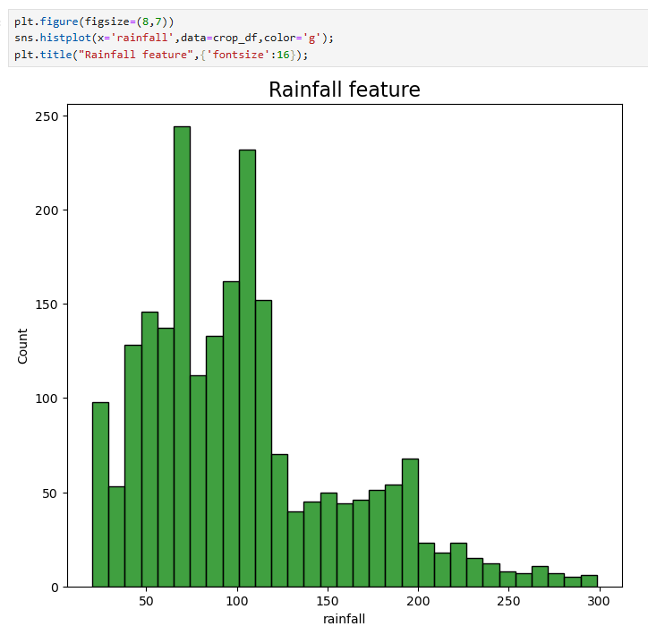
Exploratory Data Analysis
For:
The soil pH
pH stands for ‘potential of hydrogen’ and refers to the amount of hydrogen found in the soil.
pH can affect a plant’s ability to absorb vital nutrients from the soil. If pH is too acidic or alkaline, this can stunt or retard root growth and consequently, restrict water and nutrient uptake.
The rainfall

Slide 10
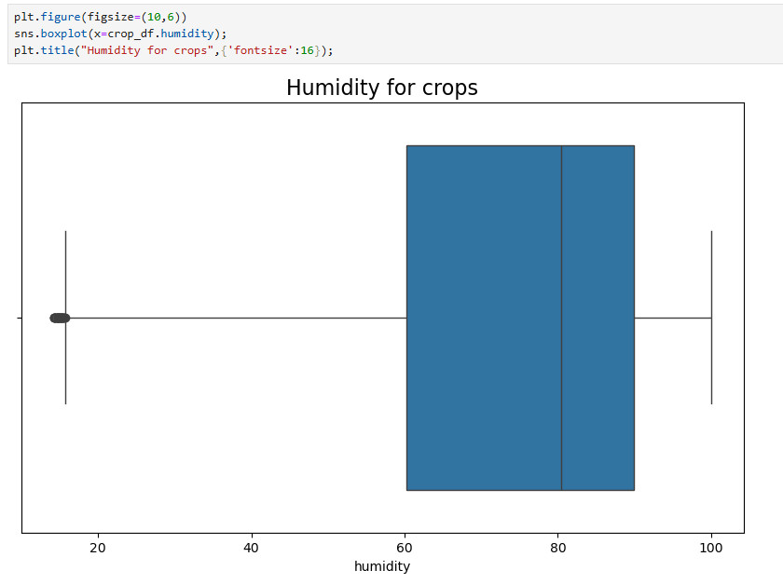
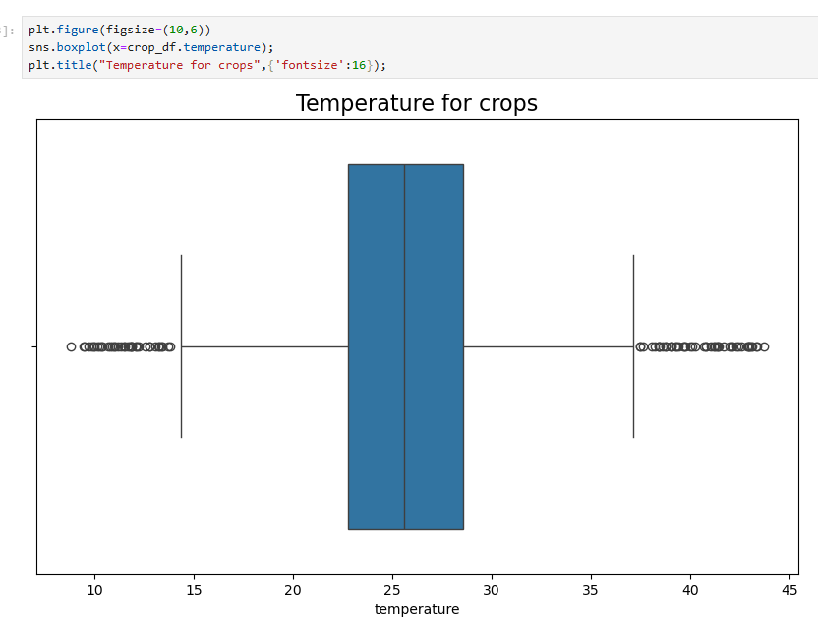
Exploratory Data Analysis
For:
Climate data of temperature and humidity.

Slide 11
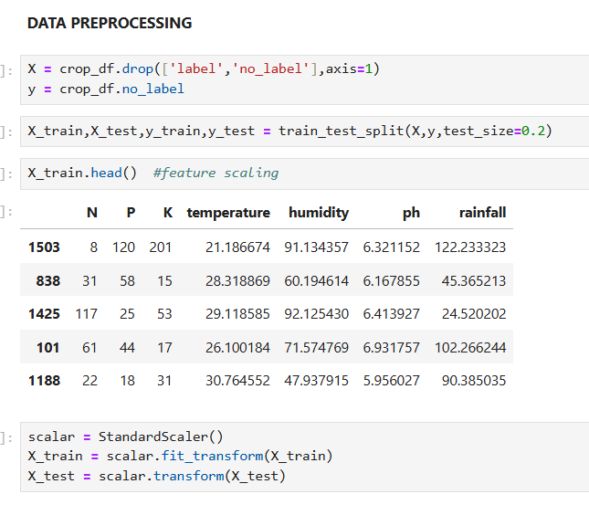
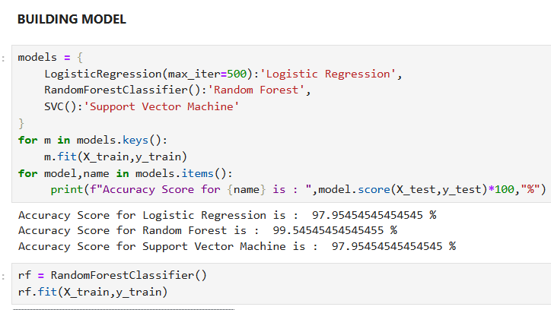
Training the Data for modelling
Best Model: Random Forest with 99.54545454545455% accuracy

Slide 12
Challenges
The model’s performance could be influenced by overfitting to the small test dataset, the potential overfitting could limit the model’s generalizability to unseen data.

Slide 13
Conclusion
The literature shows a clear trend: multi-source datasets (weather + soil + field labels+images) yield the best ML performance for crop yield prediction.
The project
Enhanced data-driven decision-making in agriculture.
Improved yield forecasting, reducing uncertainty and waste.

Slide 14

What will I do next?
Use imaging sensor data for deep learning model to predict the crop yields.

